Slide 1

GRADUATION THESIS
High quality program IT (K42)
CAN THO UNIVERSITY
COLLEGE OF INFORMATION AND COMMUNICATION TECHNOLOGY
VSTAY - A SYSTEM FOR SEARCHING AND RENTING ACCOMMODATIONS USING REACT AND NODEJS
Advisor
Dr. Thai Minh Tuan
Student
Name: Tong Minh Duc
ID: B1608292

Slide 2
Content
01 - Overview of VSTAY
Describe functions and scope of VSTAY
02 - Design and implementation
Introduce how we design and implement VSTAY
03 - Conclusion and future work
Summarize and show the future work
04 - Demonstration
Show application

Slide 3
Overview of VSTAY

Slide 4




Searching accommodation in 2021?
Searching for accommodation is a challenge
There are a lot of unreliable information
Hard to find inexpensive, spacious, and more secure accommodation

Slide 5





Searching accommodations in 2021
Solution:
A system that stored and showed accommodations
Help owners and renter to easily look for house or boarding house
Help users to find customers for renting

Slide 6


VSTAY description
A web application
Search and contact the owner of accommodation online
Support: share and find accommodation

Slide 7
VSTAY functions
Authentication (sign in/ sign up)
Upload post (for seeking or renting accommodation)
Search posts
Like/dislike posts
Update profile
Update password
Watch detail of posts
Online chat
Map function

Slide 8
2. Design and Implementation

Slide 9


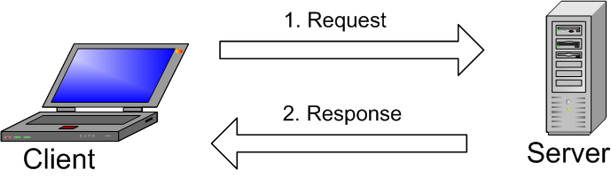







Technologies used
client-server model

Slide 10
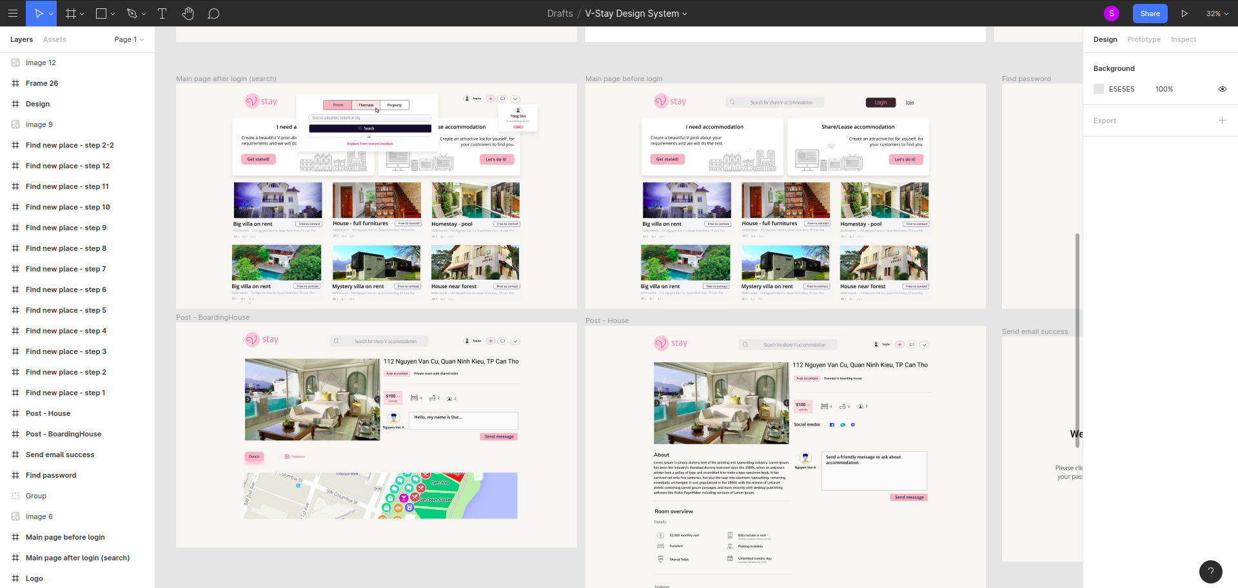
Design UI/UX
Design on Figma

Slide 11
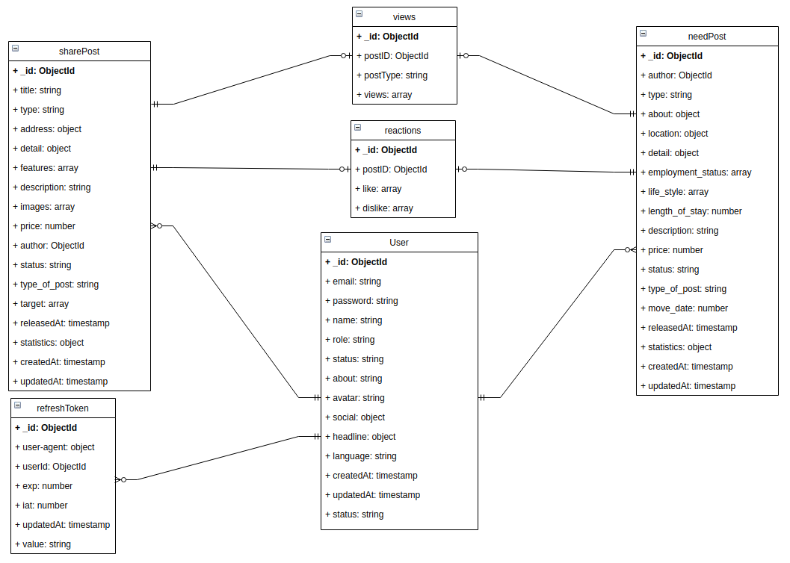
Database design

Slide 12
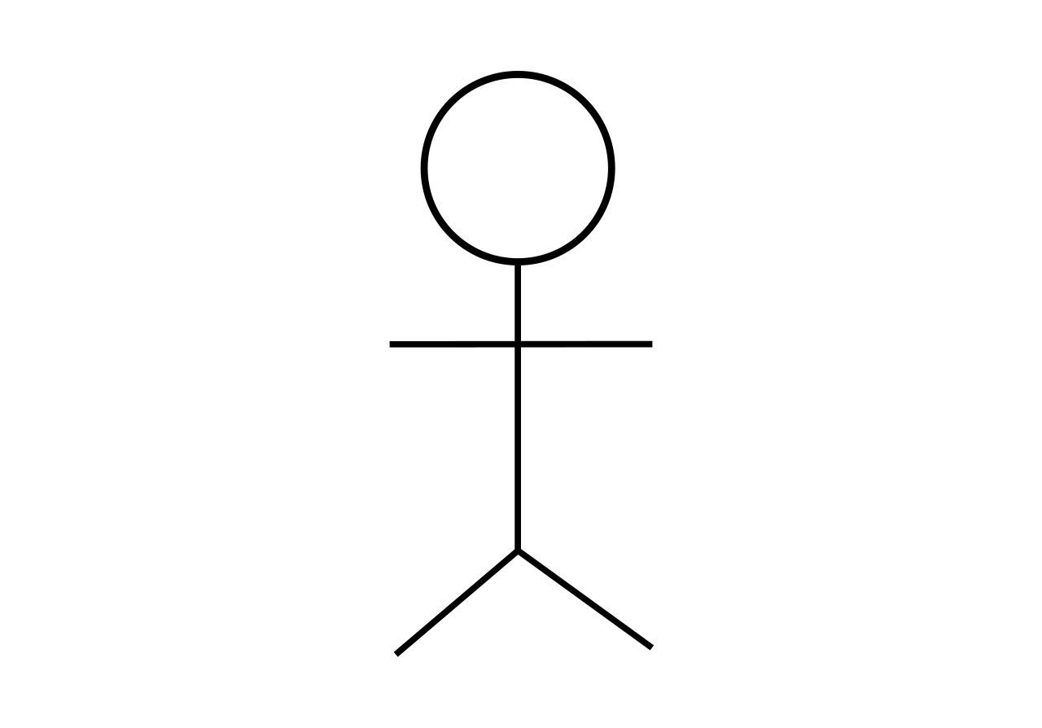
Actors
Member
Guest
Sign in
View list of posts
Search posts
Online chat
Like/dislike post
Update private user’s information
Upload posts
Update or remove owned posts
Map functions
Moderator
Sign in/ sign up
View list of posts
Search posts
Post quality assurance

Slide 13

Authentication process
Authentication
Sign in
Sign up
Users
Provide email and password to sign up
Email verification for authenticate email
using JWT (JSON web token) for signing in

Slide 14


Type of posts
Find accommodation
2 type:
Share/rent accommodation

Slide 15





Post status
Deleted
Pending
Rejected
Approved

Slide 16


Post uploading process
Member uploads a post
Post is marked “pending” status
Moderator will check and preview
Member
Moderator
Rejected
Approved

Slide 17
Scenario of testing
Test the functionalities of VSTAY
Manual testing
Test all of functionalities with scenarios
No | Description | Date
1 | Sign in function | 02/01/2020
2 | Sign up function | 02/01/2020
3 | Search function | 02/01/2020
4 | Map function | 02/01/2020
5 | Upload posts function | 02/01/2020
6 | Update profile function | 02/01/2020
7 | Chat function | 02/01/2020
8 | Update password function | 02/01/2020

Slide 18

3. Conclusion and future work
Conclusion
We created an application that helps users:
Search and rent accommodation
Upload posts to find ideal customers to rent
Create a channel to connect between owners of accommodation and customers

Slide 19

3. Conclusion and future work
Future work
In the future, we plan to:
Improve uploading posts process
Integrate machine learning
Implement more admin functions

Slide 20

4. Demonstration
DEMO TIME

Slide 21

THANKS FOR WATCHING

